Slide 1
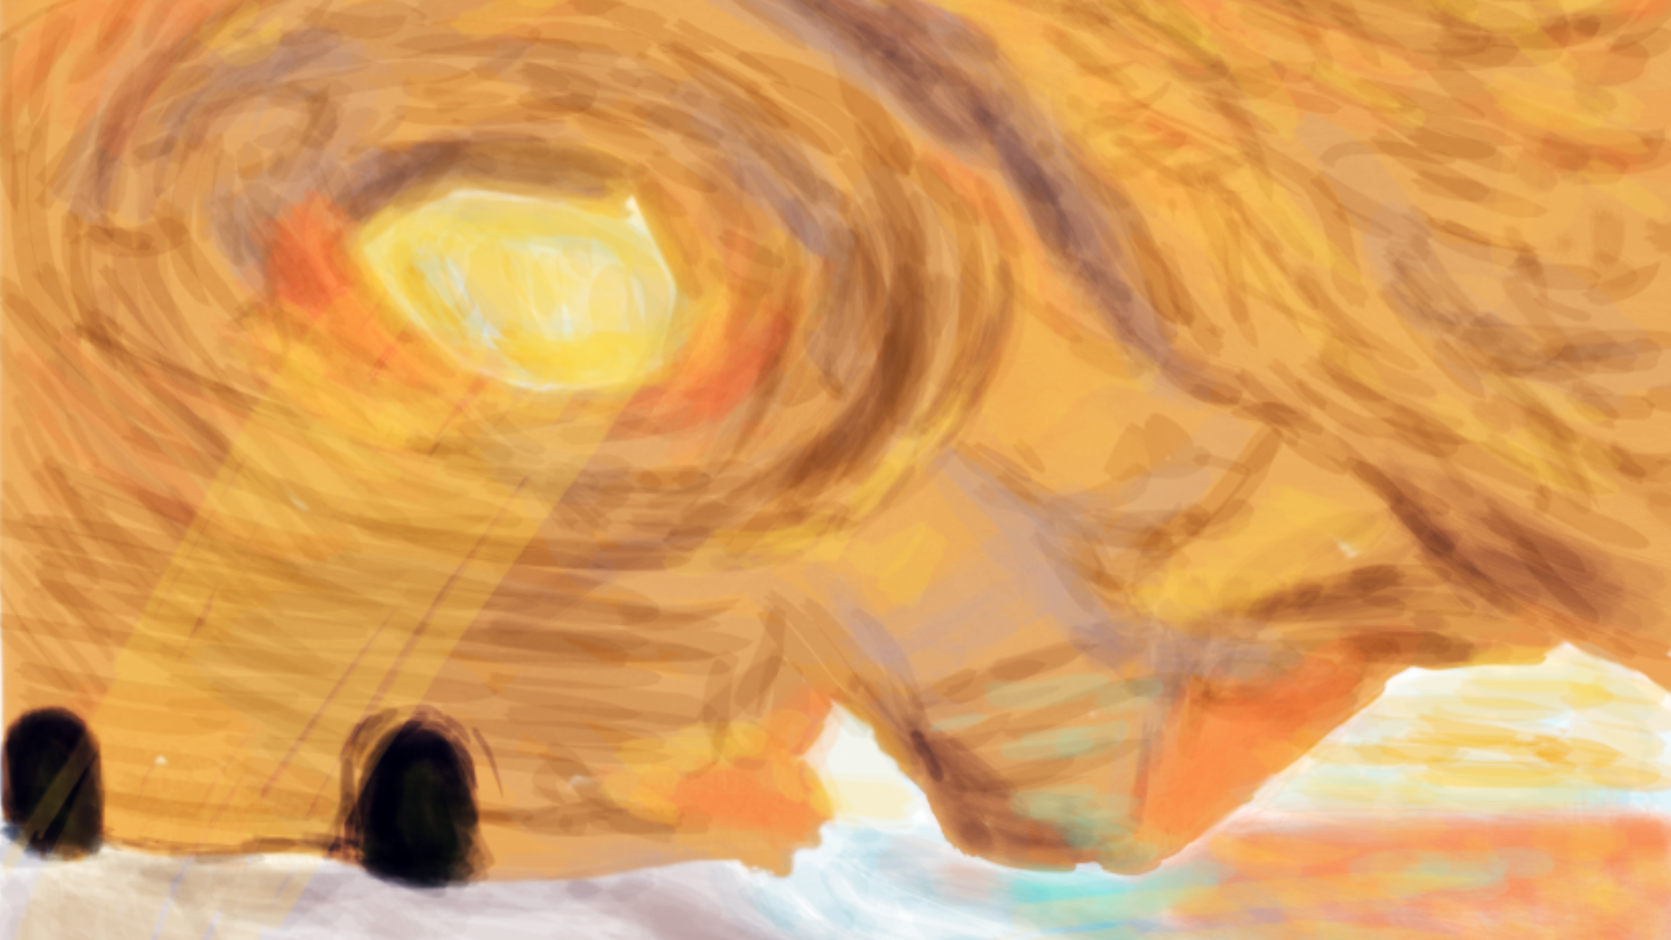
Aphasia
Beach Cave

Slide 2
Experience Overview
A patient is immersed in a VR experience where they begin their journey on a beach with a cave entrance visible. They must navigate through a cave and collect gems to open a treasure chest.
Using the computer, a therapist is able to control the difficulty of the cave path the patient is experiencing, add animals to the scene, and adjust both the lighting and volume of the scene.
User in VR experience: Patient
User controlling VR experience: Therapist
Notes:
Alyson

Slide 3
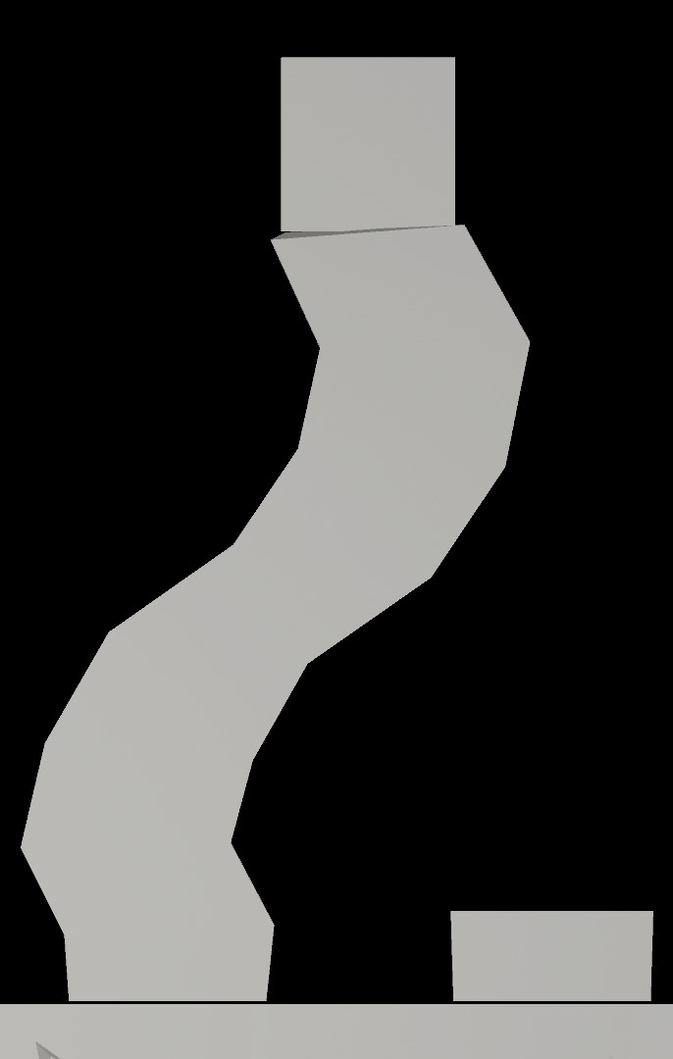

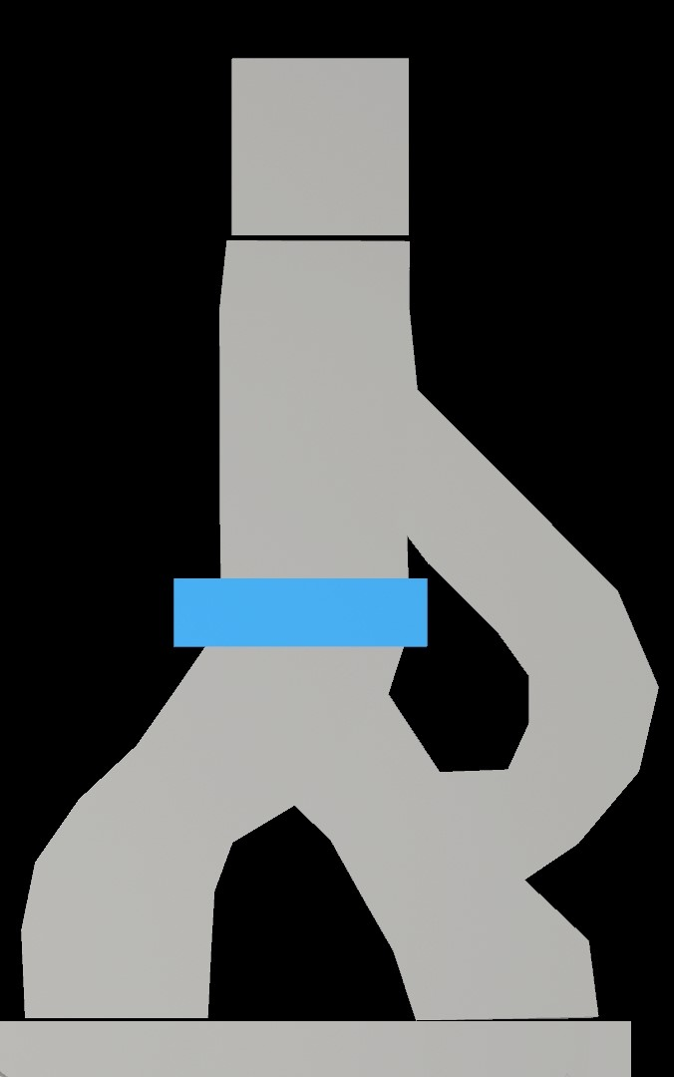
Therapist Actions
Actions set by the therapist would be set using a tablet or monitor.
The following action would be a parameter set prior to the patient entering the experience:
Select the difficulty of the cave path (easy, intermediate, and difficult).
Easy
Intermediate
Difficult
Notes:
Kaike

Slide 4
Therapist Actions, cont.
The following actions would allow modifications while the patient was in the experience:
Select the number of crabs the patient can see and hear.
Adjust the lighting of the cave.
Adjust the volume within the experience.
There will be ambient water sounds, as well as sounds emanating from the crabs. In this initial phase of the project, this control would turn all the sound up and down as a whole.
Notes:
Kaike

Slide 5
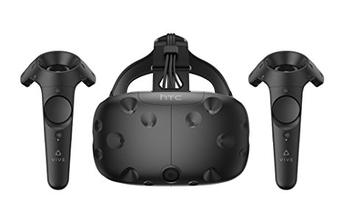
Patient Actions
Teleport, or move themselves, along a cave path.
Collect gems found in the cave.
Open a treasure chest.
Platform: HTC Vive
Patient will experience the scene inside the headset to:
View the landscape
Navigate through the cave
Collect gems
Ref: https://images-na.ssl-images-amazon.com/images/I/71oPa3WRXXL._SX466_.jpg
Notes:
Kaike

Slide 6
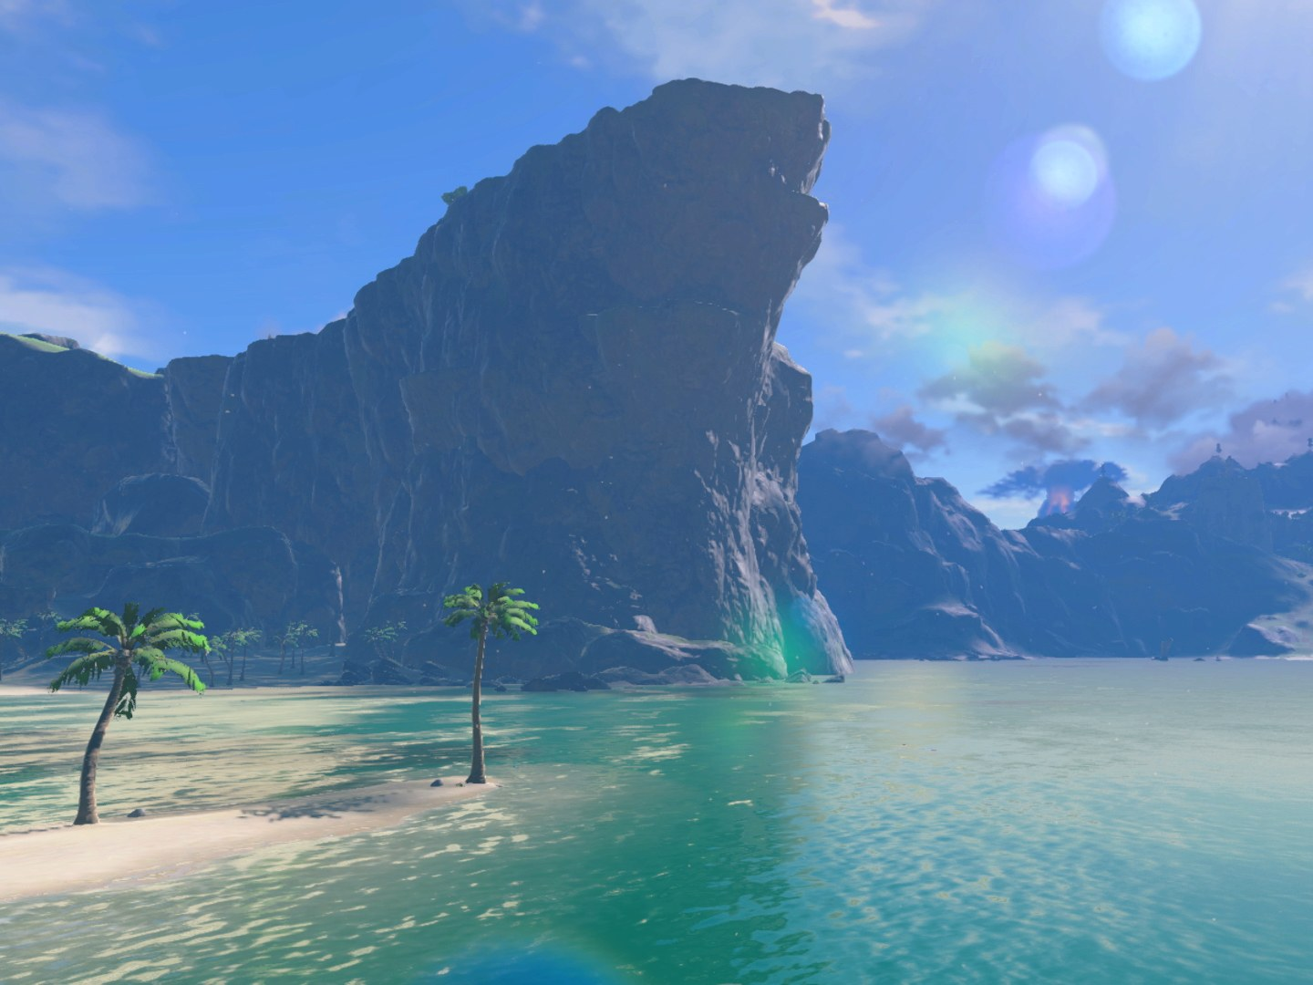
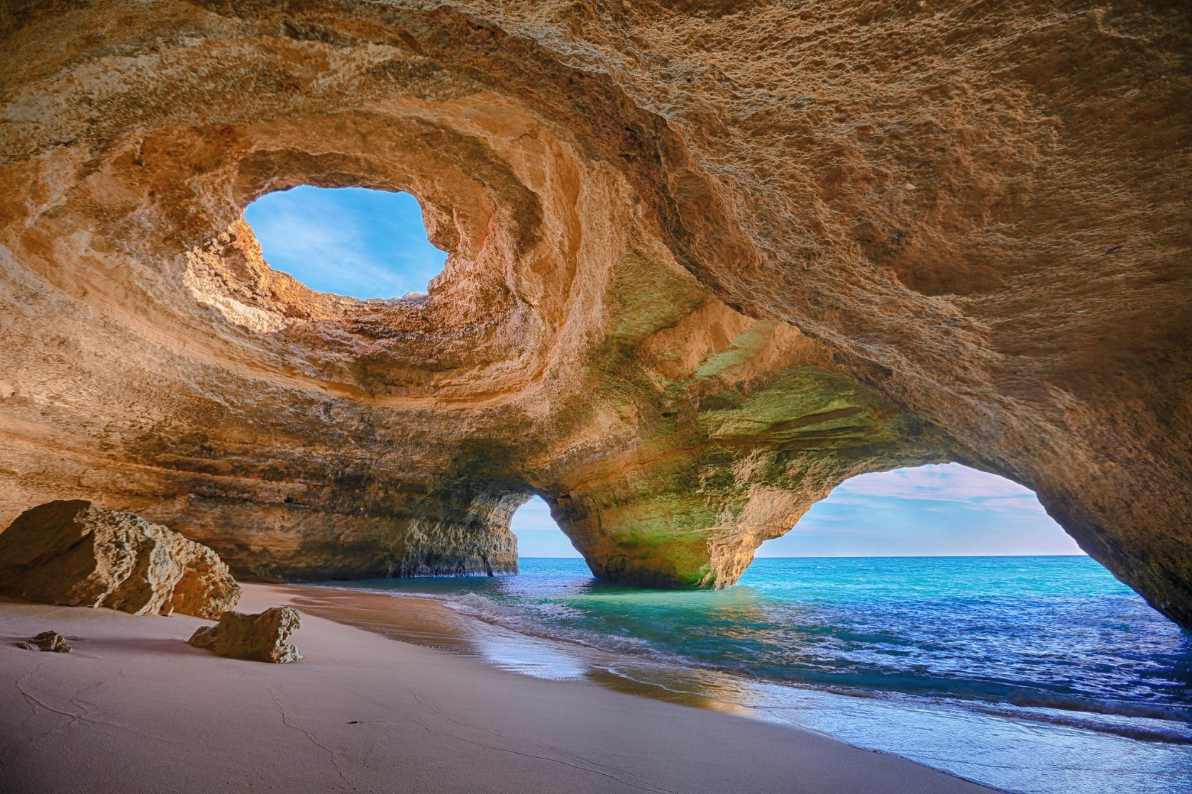
Suggested Art Style
Our goal is to create a scene that is bold and vibrant, with a painterly feel. We would like the patient to be interested in the depth and textures we create, but be able to easily discern elements in the scene.
Inspiration Image:
Reference:
https://awol.junkee.com/wp-content/uploads/2016/08/cave-e1472187313952.jpg
https://www.wired.com/2017/03/zelda-breath-of-the-wild-review/
Notes:
Liz

Slide 7
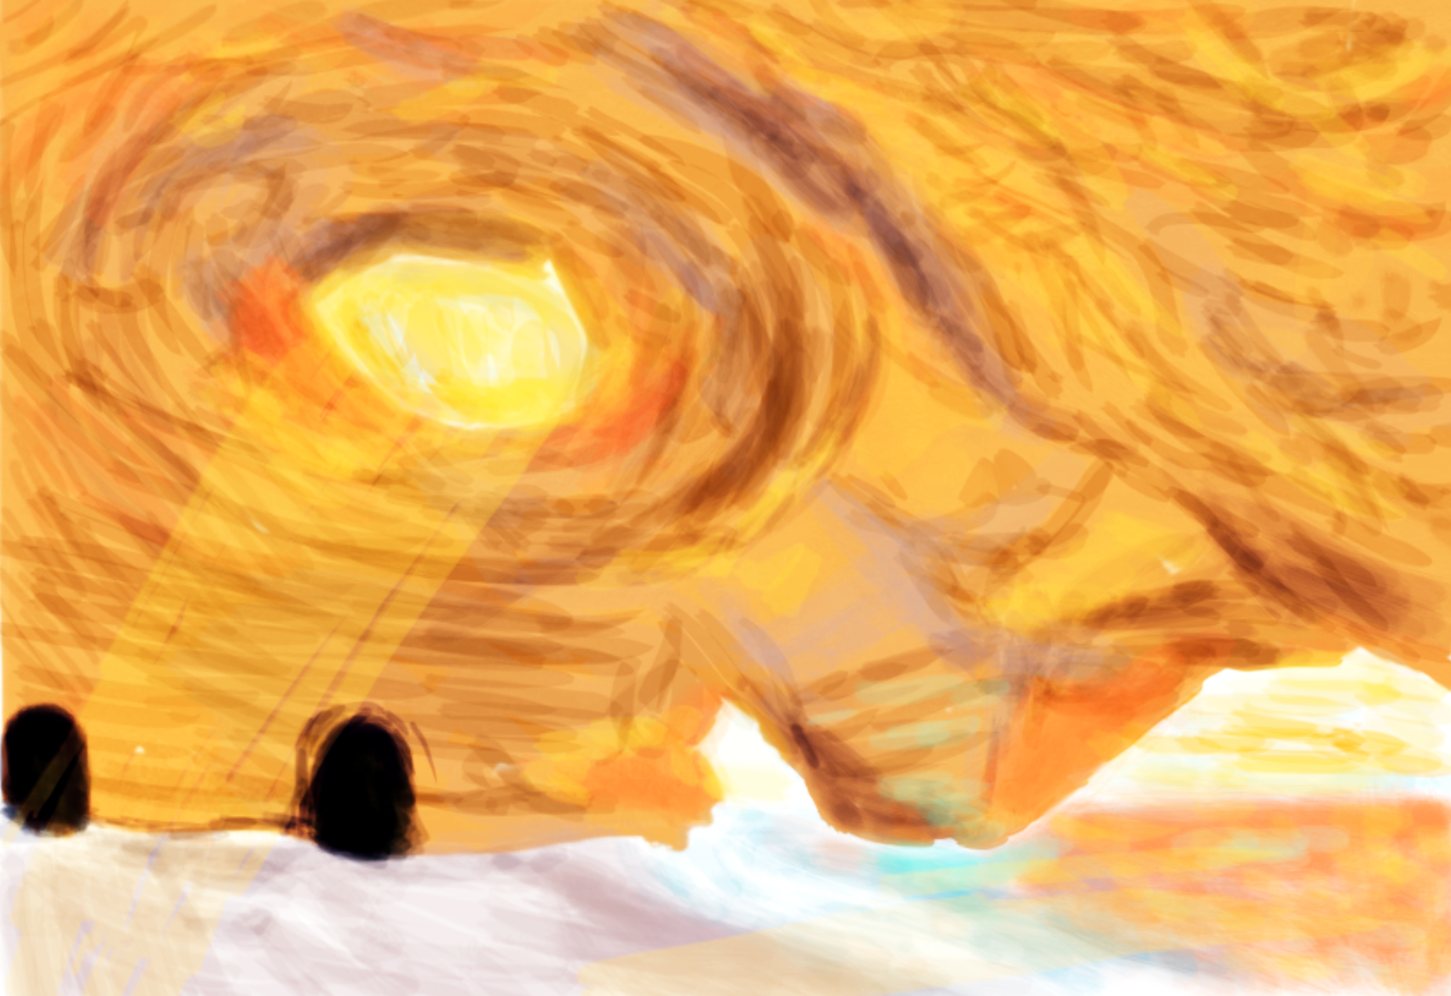
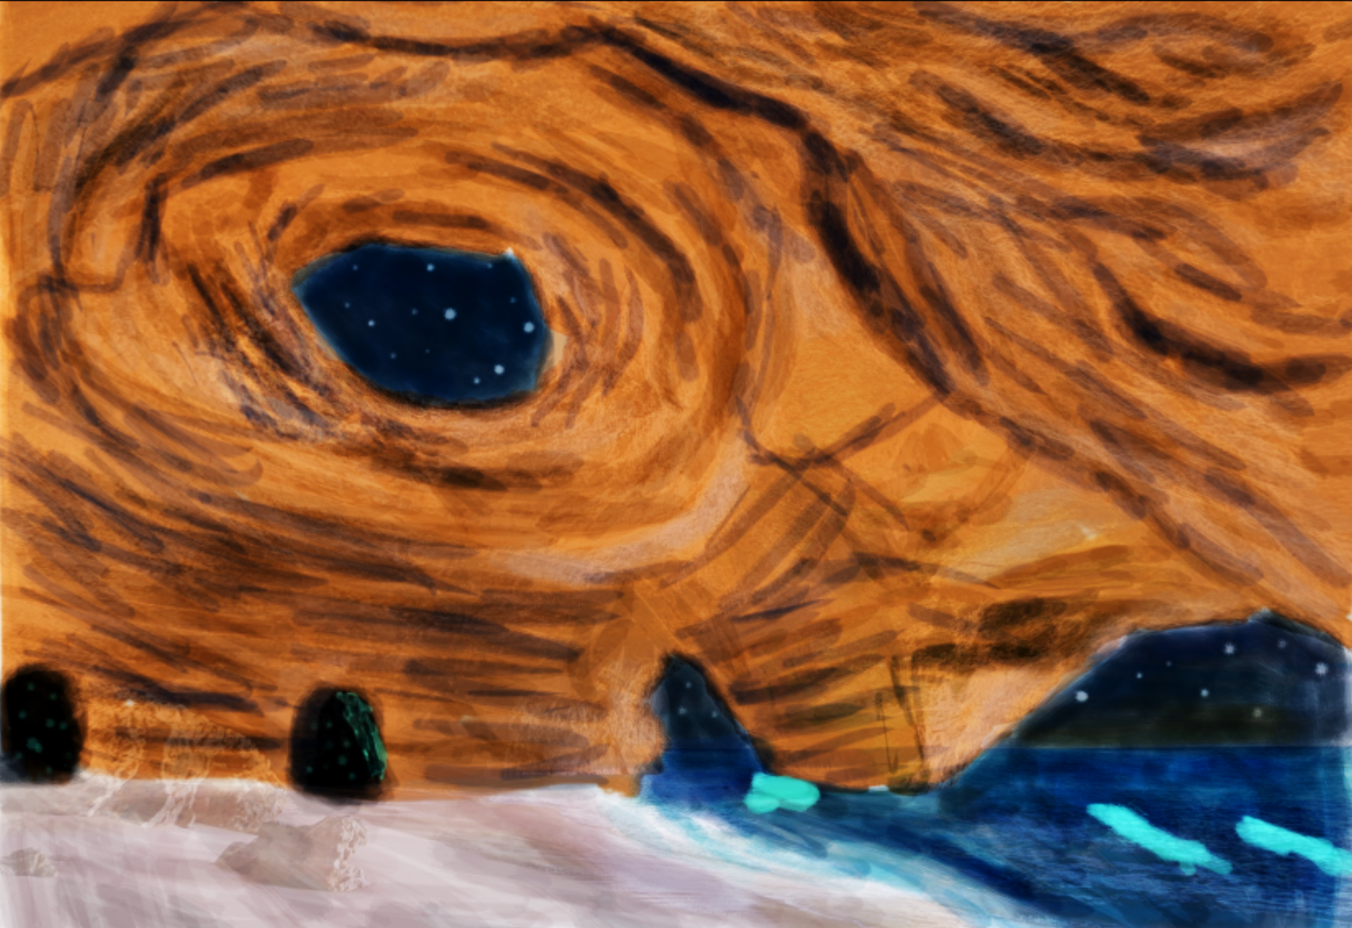
Initial Concept Art
Illustrated below are our initial concept sketches of the interior of the cave with the light dialed up for a daytime feel, then down for night..
Notes:
Liz

Slide 8
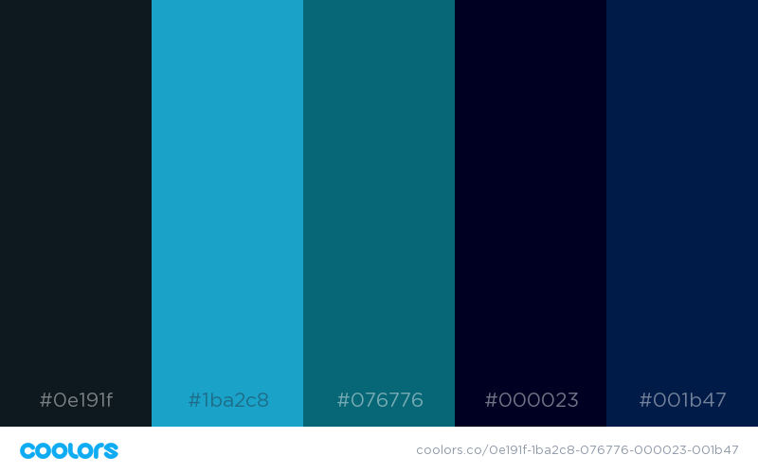
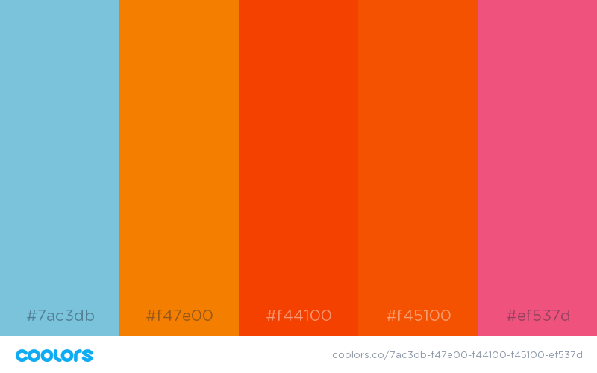
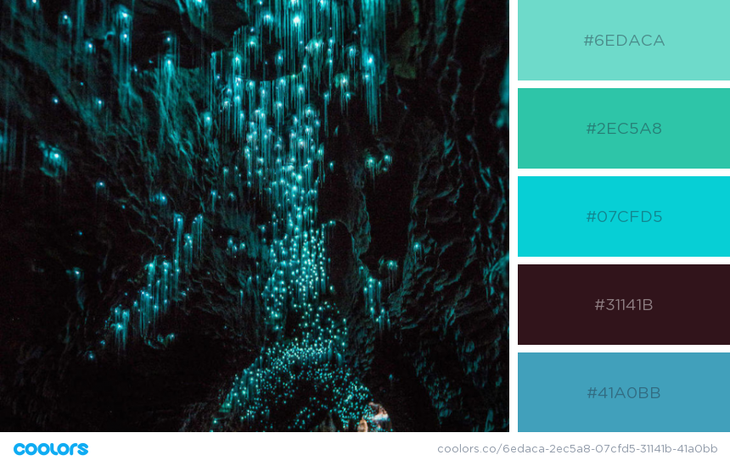
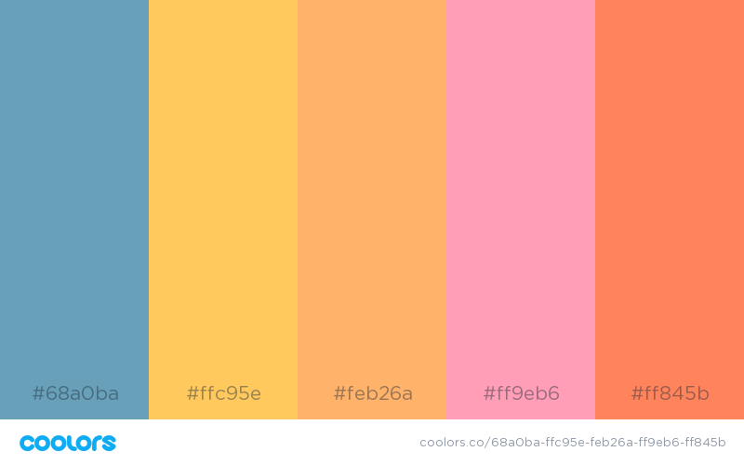

Color Palettes
Notes:
Liz

Slide 9
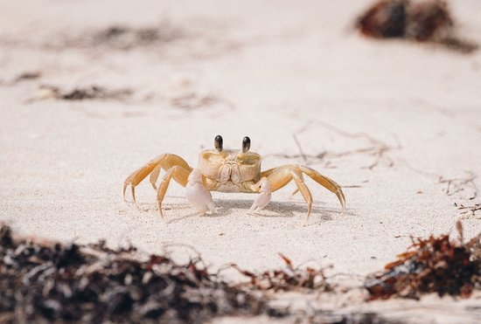
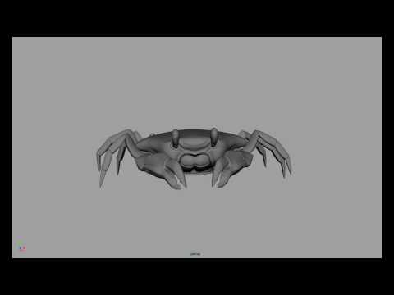
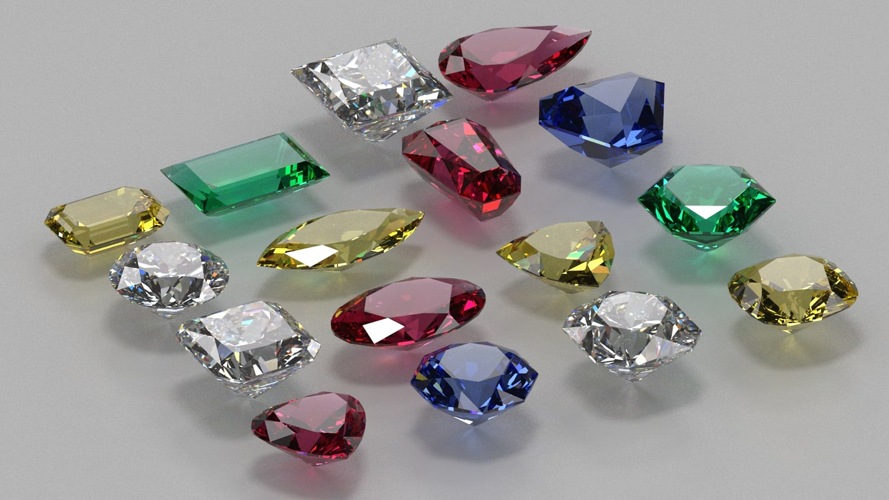
Asset Reference Images & Models
Reference for Crab Model
Reference for Animation
Reference for Jewel Model
Notes:
Chelsea

Slide 10
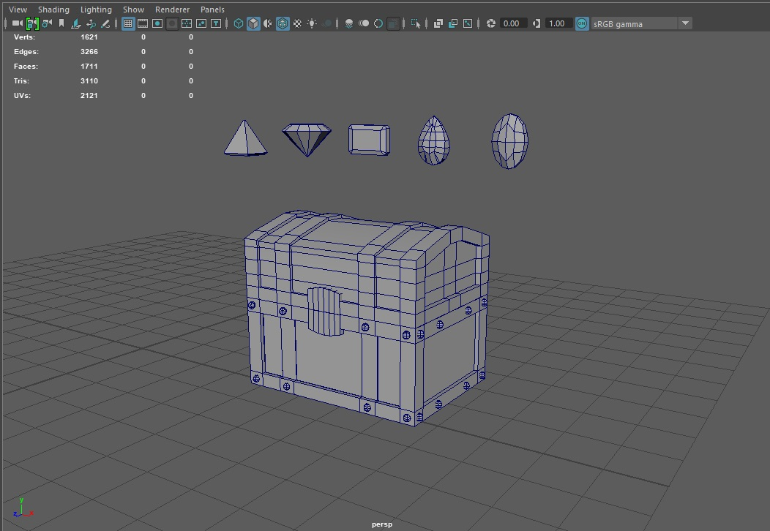
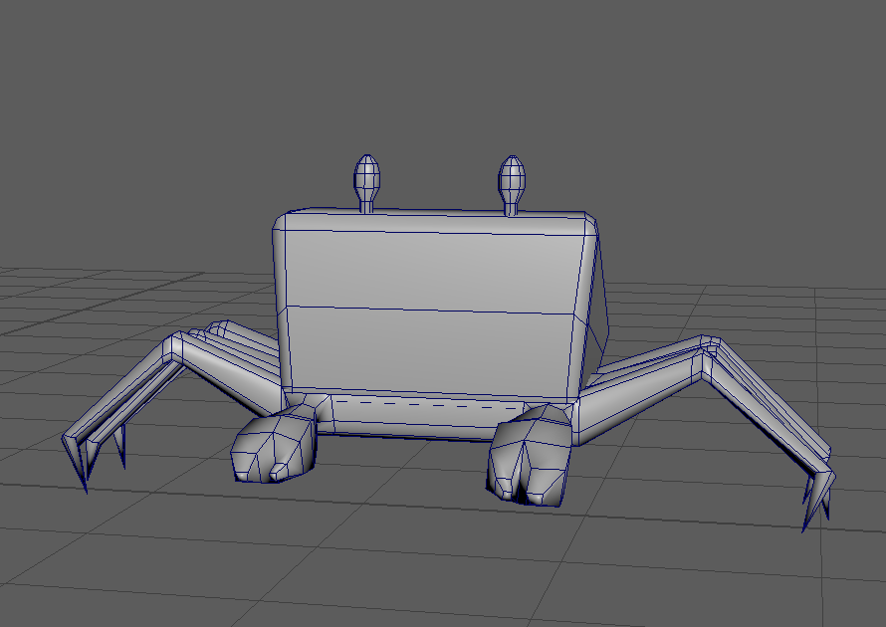
Assets In Progress
Jewels
Treasure chest
Crab
Notes:
Chelsea

Slide 11
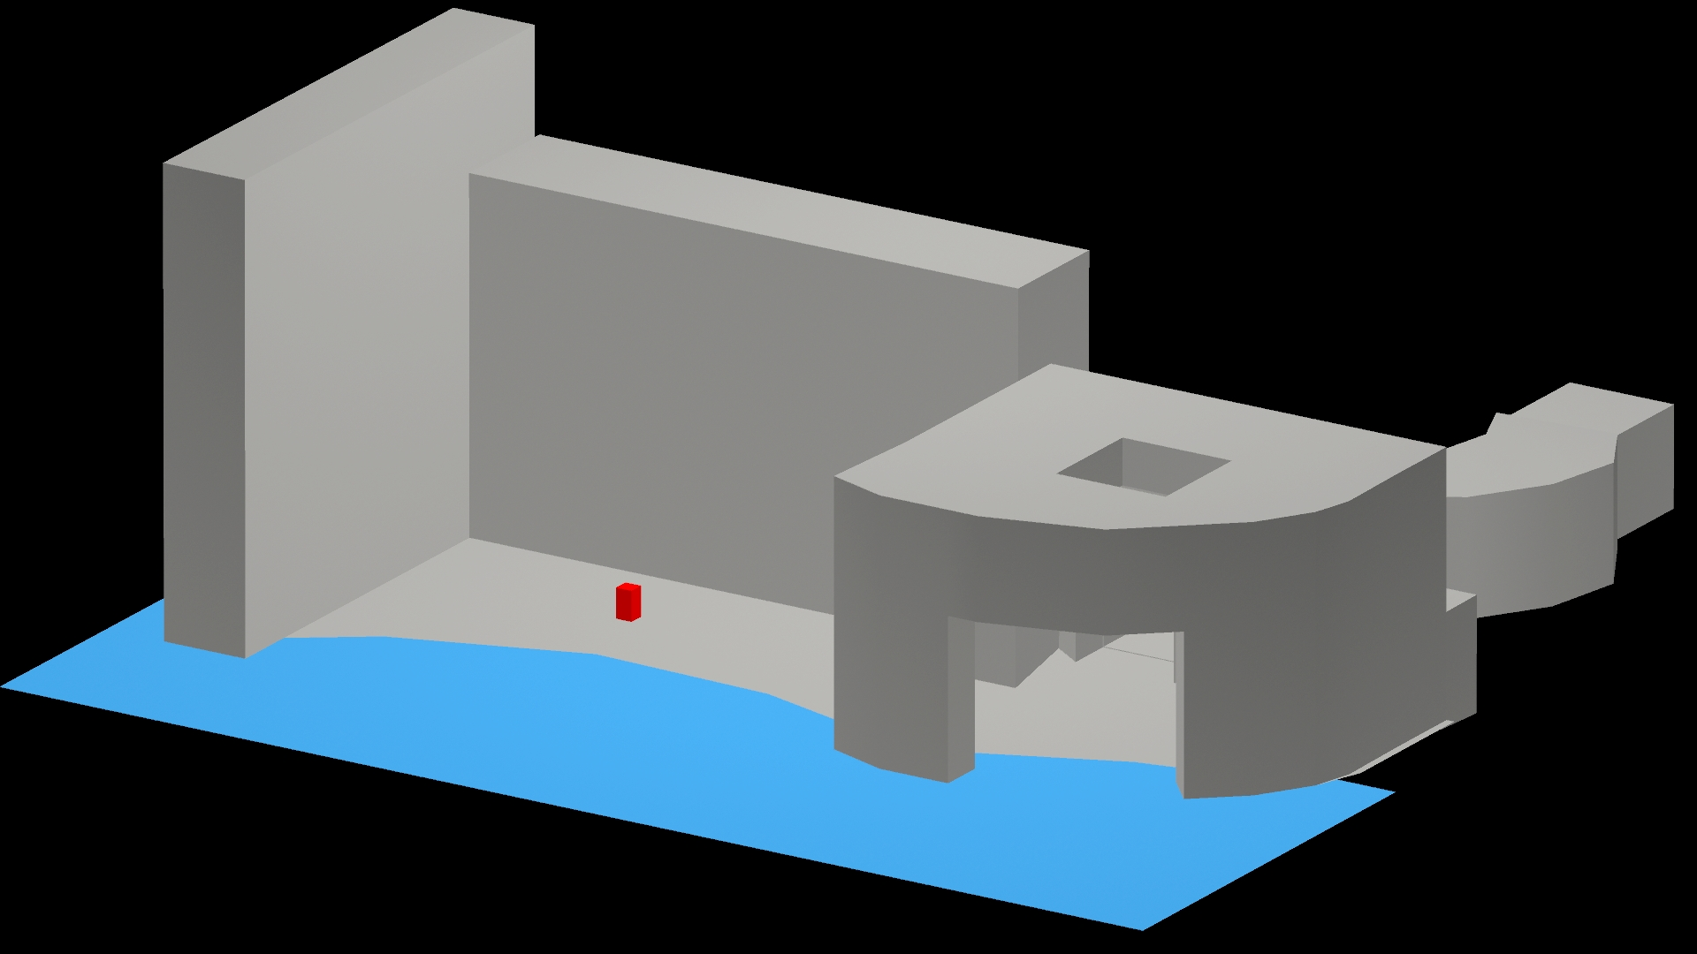
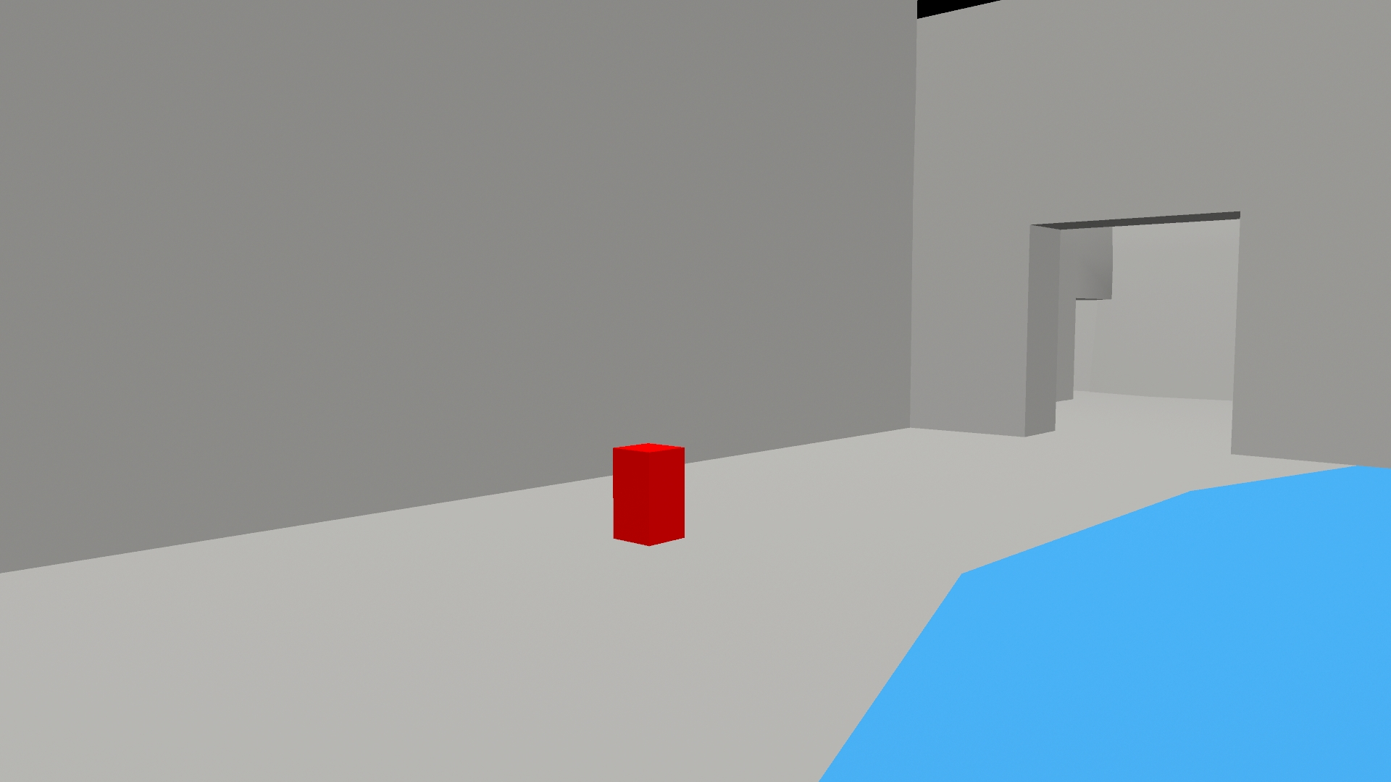
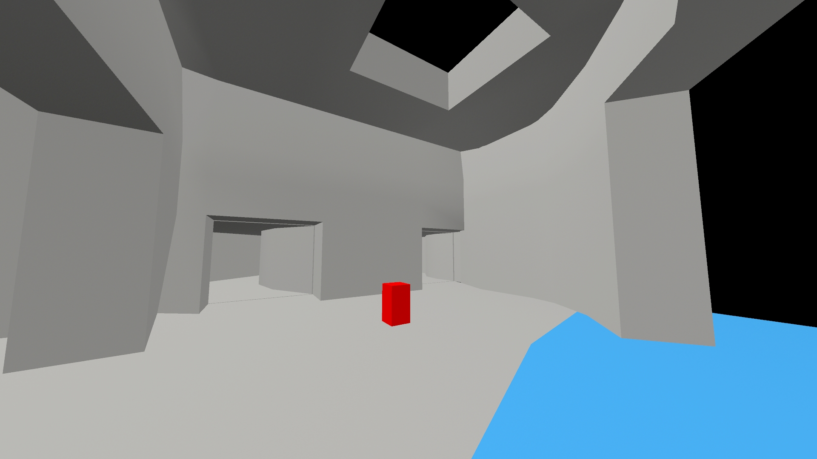
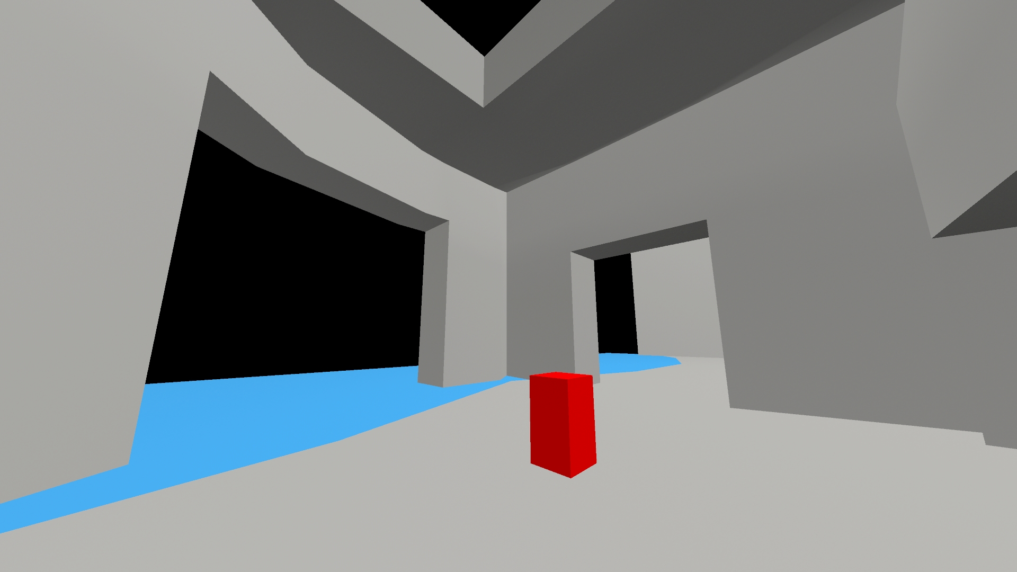
White-Boxing In Progress
A quick layout of what the scene could look like.
The red box is the Patient, the blue will be water, and the walls around are the cave and foliage that the patient must walk around.
Full Scene
Cave Entrance
Inside of Cave
Alternate View
Notes:
Liz

Slide 12

Completed Tasks
Next Steps
Model Crab
Model Jewels
Model Treasure Chest
Create Teleportation
White Box Scene
Finalize Idea
Texture & Rig Crab
Texture Jewels
Texture Treasure Chest
Model Scene
Model Foliage
Setting up Controls
Other items from today’s discussion?
Notes:
Alyson

